Slide 1

Dealing with Concurrency / Multi-Threading in .NET
Halil İbrahim Kalkan
https://github.com/hikalkan/presentations

Slide 2

What is Multi-Threading?
Executing different parts of your application code simultaneously.

Slide 3
Why Multi-Threading?
Utilizing power of multi-core processors by parallelizing CPU-bound tasks.
Responding multiple clients concurrently.
Running long tasks in background to increase responsiveness.

Slide 4
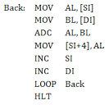
Single Core / Process Execution
SOURCE CODE
P R O C E S S
EXECUTE
S₁
S₈
S₇
S₆
S₅
S₄
S₃
S₂
S₁
S₂
S₃
S₄
CPU
S₅
S₆
S₇
S₈

Slide 5
Single-Core / Single-Processing
P R O C E S S A
P R O C E S S B
S₈
S₇
S₆
S₅
S₄
S₃
S₂
S₁
S₈
S₇
S₆
S₅
S₄
S₃
S₂
S₁
Execute
Execute
S₈
S₇
S₆
S₅
S₄
S₃
S₂
S₁
S₈
S₇
S₆
S₅
S₄
S₃
S₂
S₁
CPU

Slide 6
Single-Core / Multi-Processing
P R O C E S S A
P R O C E S S B
S₈
S₇
S₆
S₅
S₄
S₃
S₂
S₁
S₈
S₇
S₆
S₅
S₄
S₃
S₂
S₁
Execute
Execute
S₈
S₇
S₈
S₇
S₆
S₆
S₅
S₄
S₅
S₃
S₄
S₃
S₂
S₂
S₁
S₁
CPU

Slide 7
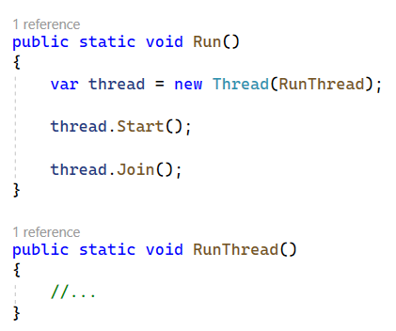
Thread: Start / Join
DEMO

Slide 8
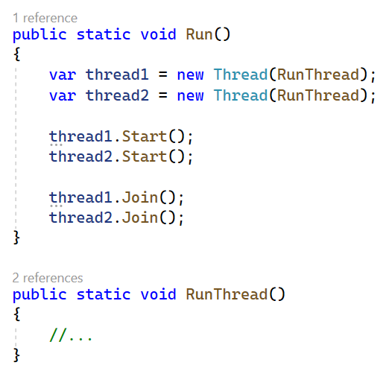
Multiple Thread: Start / Join
DEMO

Slide 9
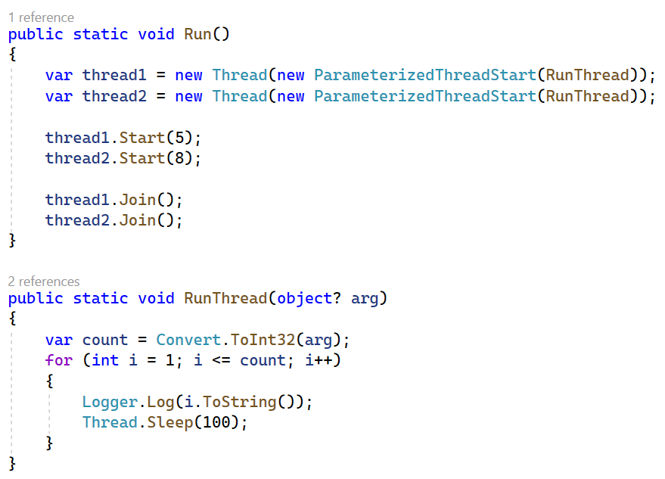
Parameterized Thread: Start / Join
DEMO

Slide 10
Sharing State Between Threads
All threads in a process share the same application state.
Should care while accessing a shared state/variable/field.
Can use exclusive locks to regulate concurrent access
DEMO

Slide 11
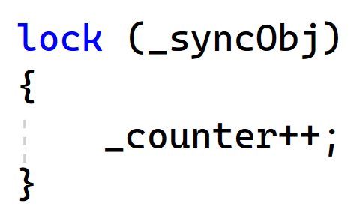
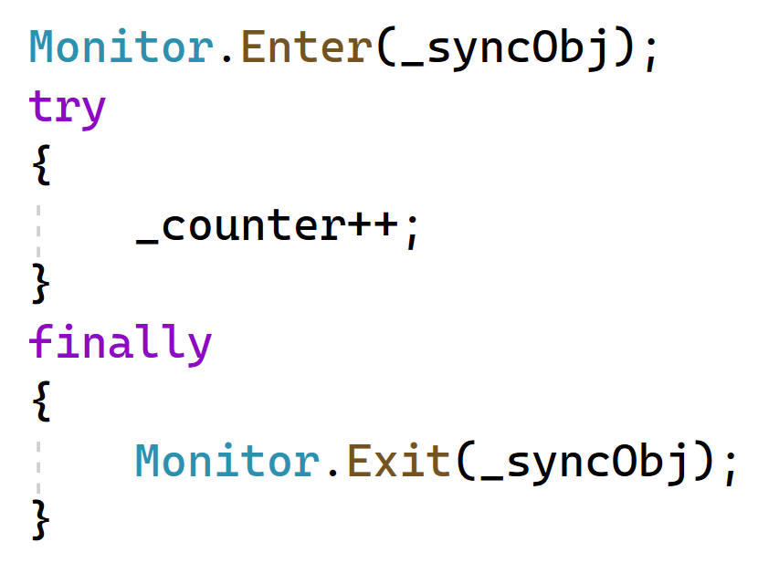
The Monitor Class
Monitor.Enter() / Monitor.TryEnter()
Monitor.Exit()
Monitor.Wait()
Monitor.Pulse() / Monitor.PulseAll()
DEMO

Slide 12
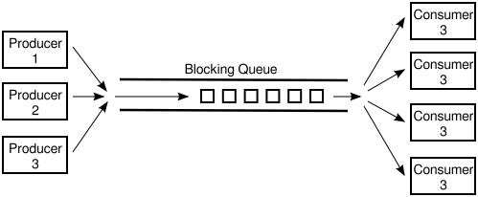
Producer-Consumer Pattern
One or multiple producer threads add work items to a queue
One or multiple consumer threads process work items and removes from the queue
Queue is exclusively accessed by all threads.
DEMO

Slide 13
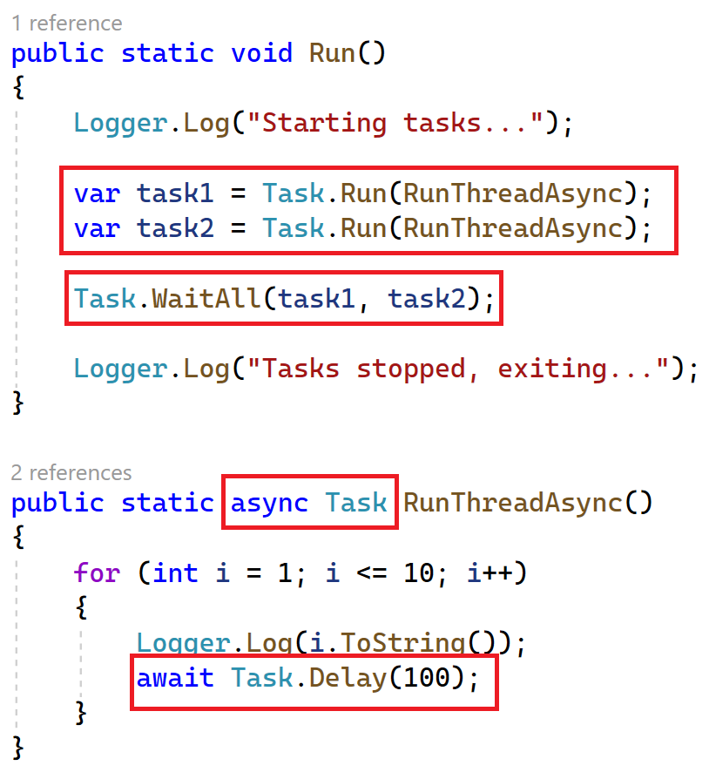
The Task Class & Async Execution

Slide 14
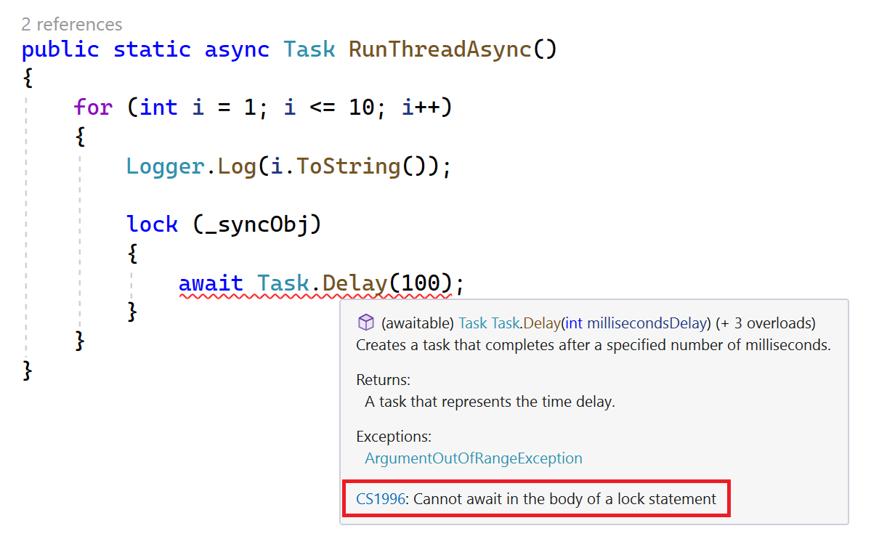
Locking vs Async Execution

Slide 15
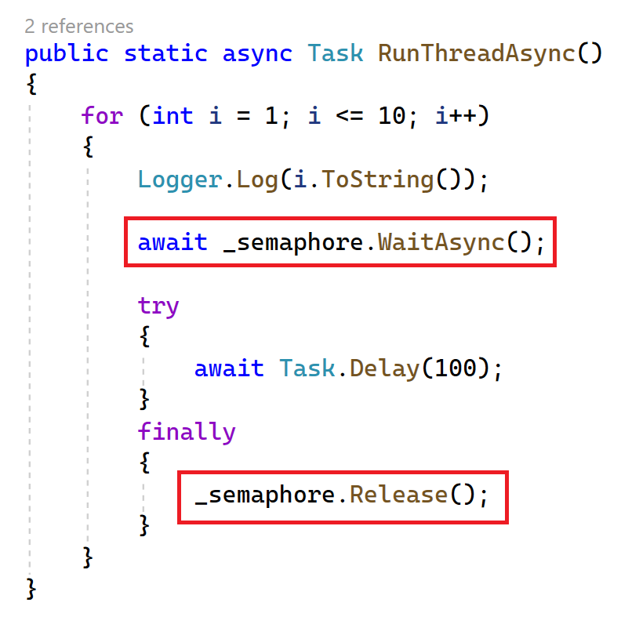
Semaphore / SemaphoreSlim

Slide 16
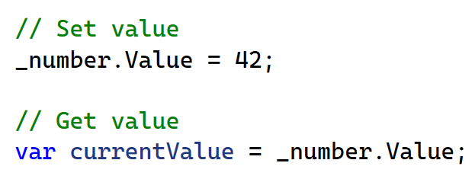
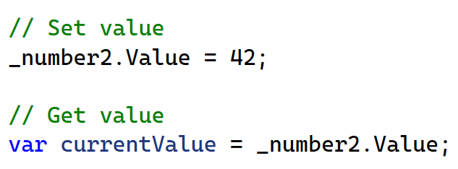
ThreadLocal & AsyncLocal

Slide 17
Inter-Process Locking
Synchronize access to resources in the same computer.
Resource: Shared files, databases, sockets, and other processes.
Same Server (and same Operating System)
Application A (Process A)
Application B (Process B)
Shared Resource

Slide 18


Mutex (mutual exclusion)
Local (unnamed) mutexes: Thread synchronization
Named system mutexes: Process synchronization

Slide 19
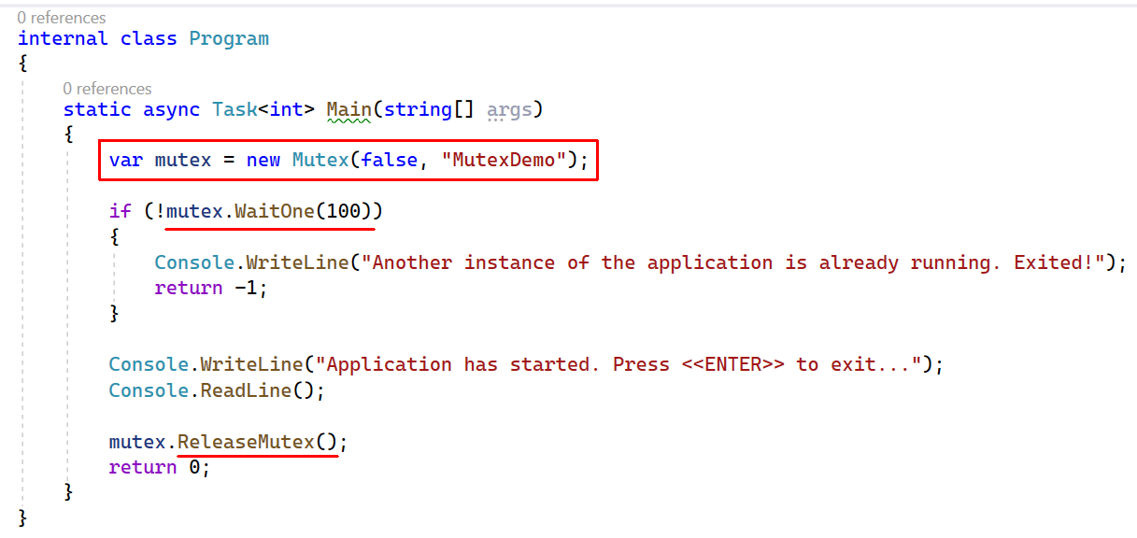
Mutex: Interprocess Locking

Slide 20
Mutex: Interprocess Locking
DEMO

Slide 21
Distributed Locking
Create locks to synchronize multiple processes running in different servers.
Why we need it? Some examples:
To process a background job or message queue
To synchronize access to a shared resource
Apply database migration scripts / seed initial data
To populate a cache object

Slide 22

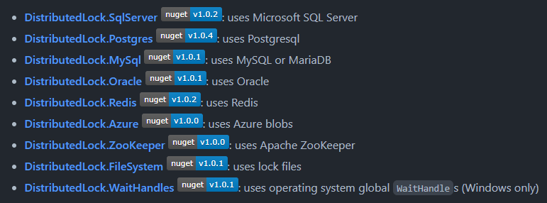
The DistributedLock Library

Slide 23
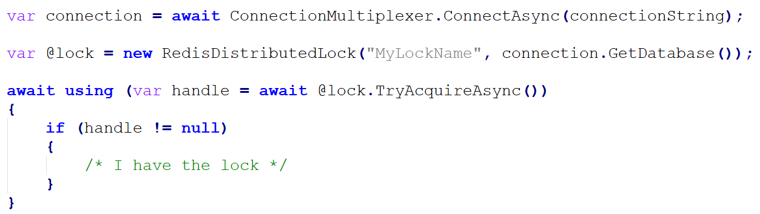
The DistributedLock Library

Slide 24

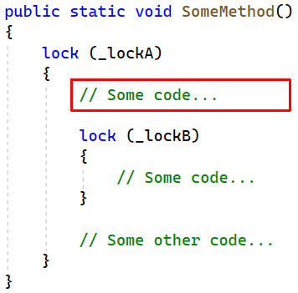
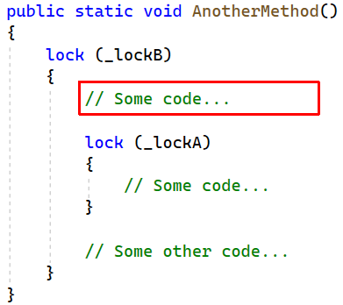
Nested Locks & Deadlocks

Slide 25
Thanks!
Get This Presentation
https://github.com/hikalkan/presentations
Contact Me
Home: https://halilibrahimkalkan.com
GitHub: @hikalkan | Twitter: @hibrahimkalkan
References
https://learn.microsoft.com/en-us/dotnet/standard/parallel-programming/
https://learn.microsoft.com/en-us/dotnet/api/system.threading.mutex
https://github.com/madelson/DistributedLock

Slide 26
Topic title
Content

